Slide 1
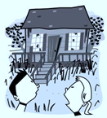
The Beach House
———Focusing on detailed description

Slide 2
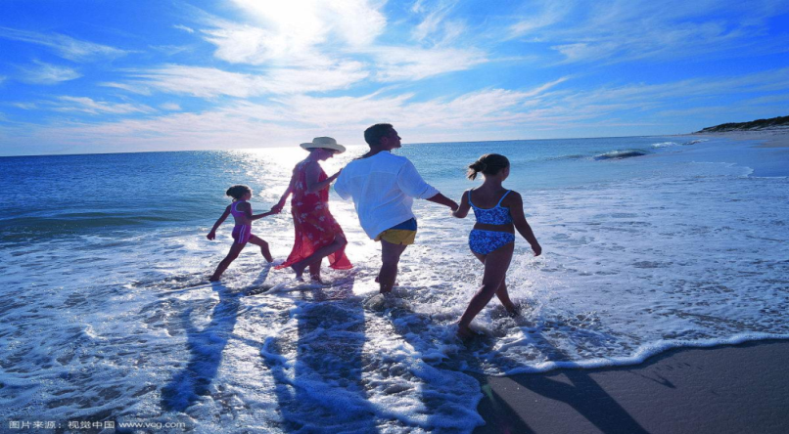

The story
a perfect family summer seaside holiday
how
who
when
where
what

Slide 3
Organization
scared
Inside
curious
relieved
Into
Out of
relaxed
---
Outside
outside

Slide 4

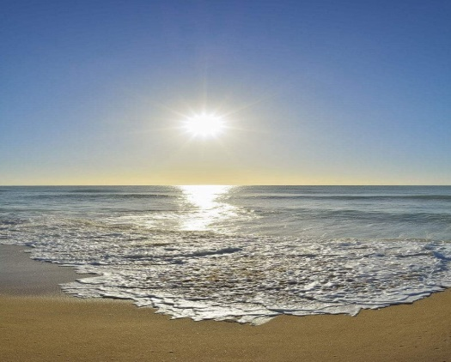


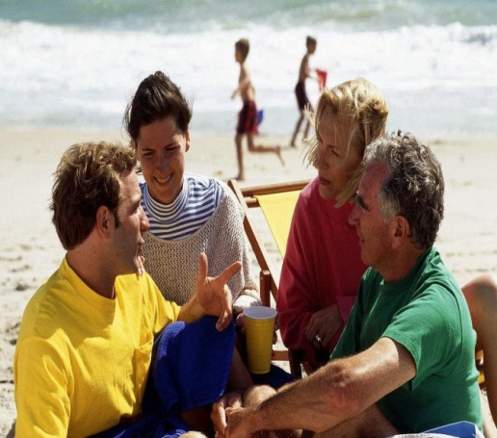
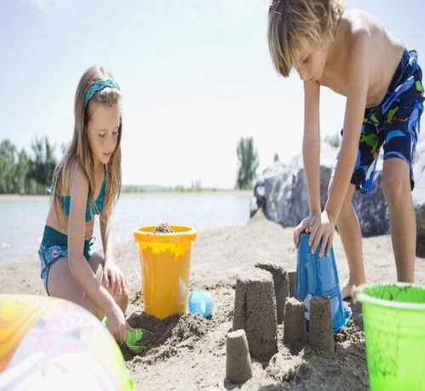

Outside the House (Para 1-2)
floating clouds
glistering water
scattered seashells
To give detailed description of the surroundings and what people do.
How does the author show they were having a perfect and relaxing holiday?

Slide 5

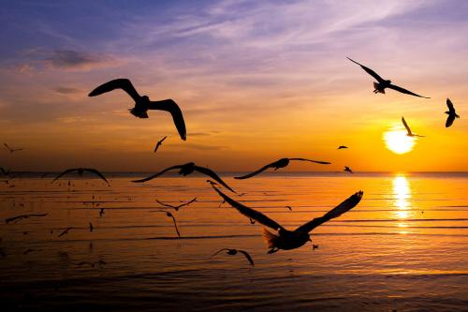
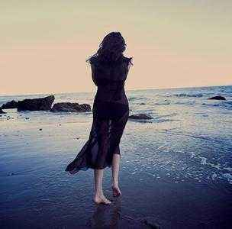
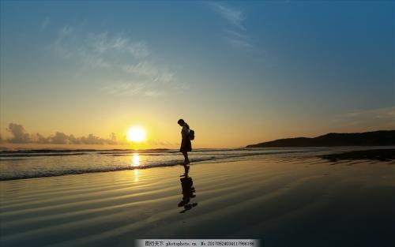
Detailed description of surroundings
A soft breeze gently kissed her hair. The golden red sun was setting. She was spellbound by its color, softly fading into yellow. She could hear nothing but the waves and the seagulls flying up above. The last sunshine gradually cast her shadow on the beach, leaving a long and charming figure in sight.

Slide 6
Into the House (Para 4)
The front steps to the doorway of the house creaked as they carefully climbed up them, so did the porch when they stepped onto it. The dusty windows and porch railing were badly weathered and broken. The front door was half open so they squeezed through and cautiously entered. The place was in a total mess, covered with dust, sand, dead leaves, and overturned furniture. They’d taken but a few steps when the door unexpectedly slammed shut behind them.
How does the author show they were curious and cautious?
To use specific vivid verbs and adverbs to describe actions.

Slide 7
Inside the House (Para 5-6)
Frozen with fear, Paula was too scared to move an inch.
Seized by a huge surge of panic, she remained motionless.
Her face turned pale and palms were sweating.
He pointed to the door, with his fingers trembling.
She was so scared that her mouth went dry.
Instantly a sense of terror crept upon him rippling across(spreading through) his while body. He felt every single hair stood on end.
To include details of people’s physical and mental response.
How can you show they were scared? What detailed descriptions can be included to continue the story?

Slide 8
Inside the House (Para 5-6)
----“let’s get out of here, Paula!” screamed Krin.
----“But---ho---how can we make it?” stuttered Paula with a worried look.
----“Hey, bro, look over there in the back bedroom, the window is open.” whispered Paula.
----“Yeah, hurry up, let’s jump out of it.” nodded Krin.
To properly and naturally use dialogues.
.

Slide 9
Inside the House (Para 5-6)
At that critical moment, the survival skills learned at school flashed across his mind. “Yeah, that’s a good idea,” his face lit up.
Desperate and hopeless, they felt as if the world came crashing down. Then suddenly Mom’s encouraging words echoed in his brain, a ray of hope flickering in her eyes. ”I shouldn’t give up easily,” Krin determined.
To include mental activities.

Slide 10
Inside the House (Para 5-6)
Without the slightest hesitation, Krin grabbed his sister’s hand and dashed into the back room.
Hand in hand, they cautiously tiptoed to the back room. Unluckily, Krin tripped and fell before they got out of the haunted house.
They opened the window, jumped out of it and ran as fast as their legs could carry.
To include detailed description of actions.

Slide 11

Application of detailed description
杰克和妈妈争吵之后离家出走。独自在街道上游荡，身无分文，饥饿难耐。偶遇一位热心老板，免费给他一碗面条。感激之情，难以言表。而老板说，“最应该感谢的是你的妈妈。”杰克意识到自己的错误，决定回家向妈妈道歉。请运用环境描写、动作描写和心理描写等设计一段杰克在见到妈妈之前的描写，首句已给出。
Darkness increased and Jack made his way towards the house.________________________________________________________________________________________________________________________________________________

Slide 12
Application of detailed description
Darkness increased and he made his way towards the house. Heart beating wildly and mind racing swiftly, he cautiously got closer, inch by inch, and hesitantly knocked on the door with a trembling hand. No answer. “Where could Mom have gone?” wondered Jack, confused. Then the seller’s words flashed across his mind again. Countless harsh winter dawns had witnessed mom rising early cooking breakfast for him. But never once had he said a single Thank You to her. Eyes glistening and throat tightening, he resolved to apologize to her. Then he felt a gentle touch on his head--

Slide 13
Reflecting on detailed description
To describe the surroundings and what people do.
To use specific vivid verbs and adverbs to describe actions.
To include people’s physical and mental response
by using sensory language.
To properly and naturally use dialogues.
To include mental activities.
---
How to give a detailed description?

Slide 14




Continuation writing tips
Read more
Accumulate more
Imitate more
Acquire more

